Slide 1
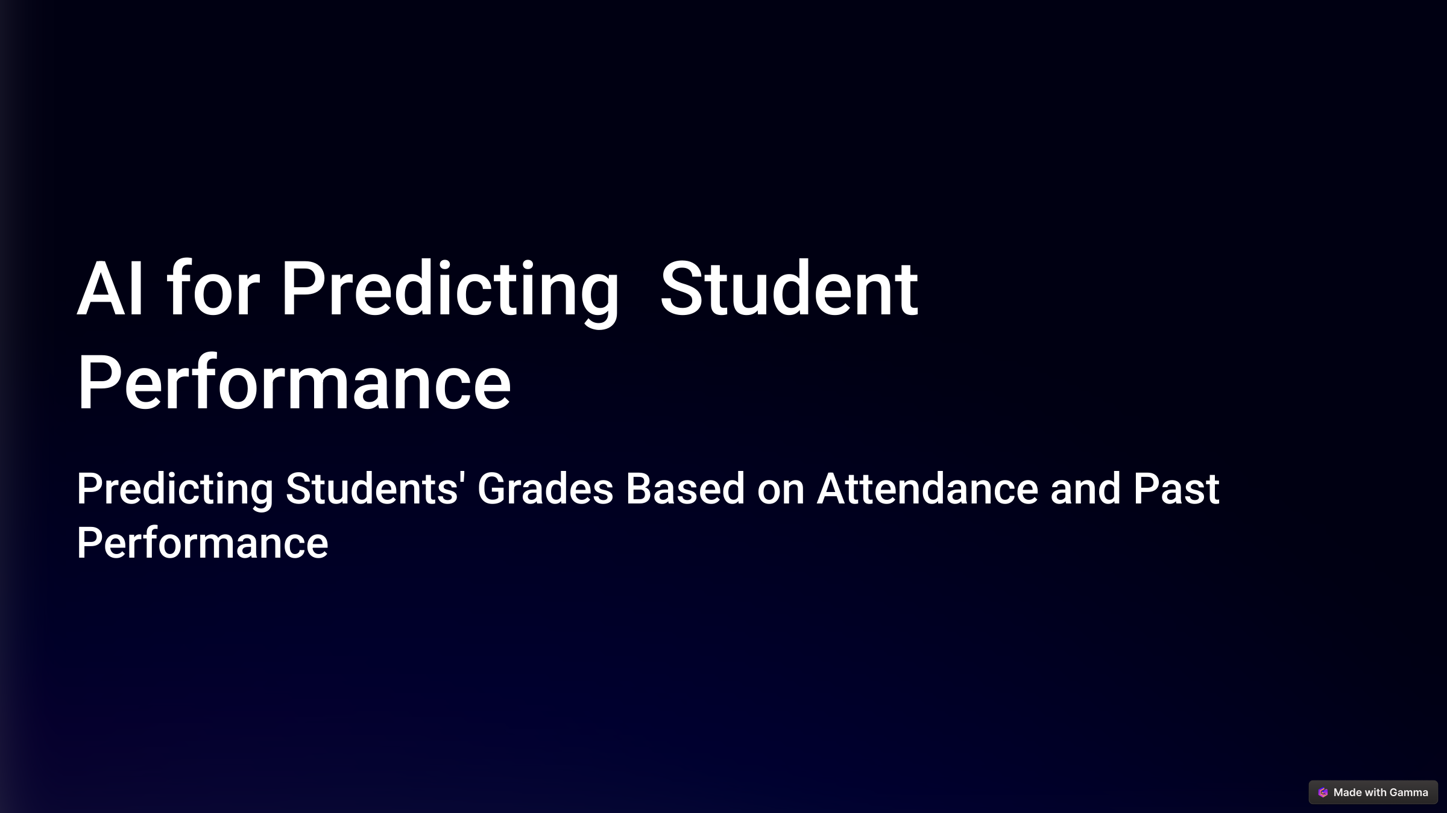
Ananya – 11278
Roll no. – 2410031420
Section – 1CSE22 (IBM CE)

Slide 2



AI for Predicting Student Performance
Predicting student success is a critical challenge for educational institutions. This presentation outlines our approach to building an AI model that uses historical academic data, attendance, and past performance to forecast student grades. By leveraging machine learning, we aim to identify at-risk students early, enabling timely interventions and personalized educational strategies.
Our model provides actionable insights that can help educators improve student outcomes. We'll cover data collection, model selection, training, and evaluation. Let's explore how AI can transform education and support student achievement.
by Ananya

Slide 3
Introduction
Overview
Problem Statement
AI can significantly enhance educational outcomes by analyzing historical academic data. Our project focuses on building a machine learning model to predict student grades using key features such as attendance, past grades, and various academic factors.
Many educational institutions struggle to identify and support at-risk students early enough. Traditional methods often fall short in providing timely interventions, leading to poorer academic results and increased dropout rates.
Our model addresses this challenge by providing a data-driven approach to predict student performance, allowing for targeted interventions and personalized support systems.
This approach offers a proactive solution to identifying students who may require additional support, ultimately improving overall academic performance and student retention rates.

Slide 4



Objective
Goal
Our primary goal is to construct a robust machine learning model capable of predicting student grades. This model will be trained using historical academic records, attendance data, and past performance metrics to ensure accurate and reliable predictions.
Use Cases
The applications of our model are extensive. It allows for early intervention for at-risk students, providing them with the necessary resources and support to succeed. Additionally, it enables personalized educational strategies, tailoring learning experiences to meet individual student needs and improve overall outcomes.

Slide 5
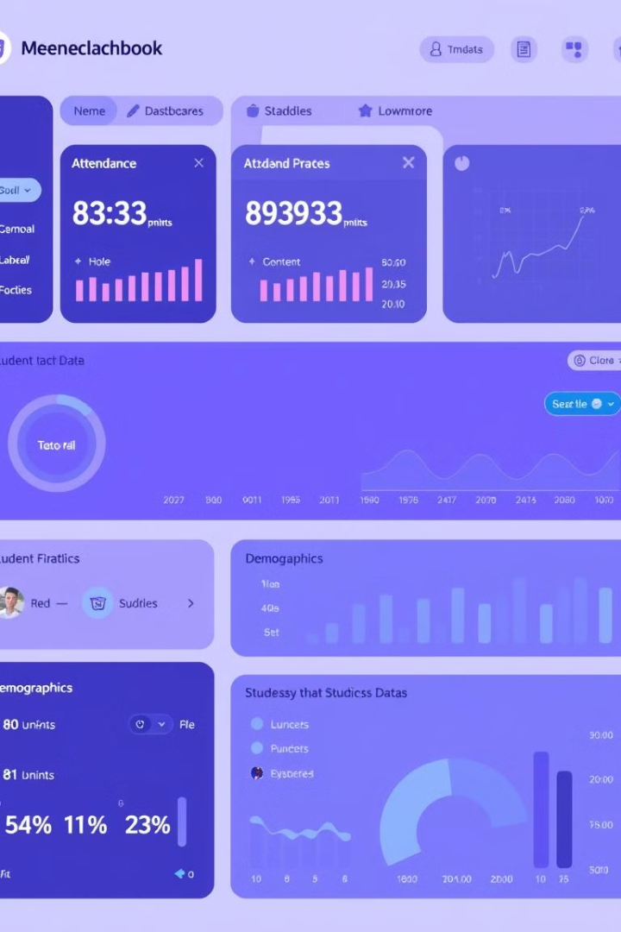


Data Collection
Dataset Overview
Data Preprocessing
Attendance records: Tracking student presence in classes.
Handling missing data: Imputation techniques to fill gaps.
Previous grades: Scores in exams, assignments, and projects.
Normalization: Scaling numerical values for consistent analysis.
Demographic information: Age, gender, and socio-economic background.
Data Cleaning: Removing inconsistencies and errors.
Other academic factors: Class participation, behavior, and engagement.

Slide 6
Features and Labels
Features
Attendance rate: Percentage of classes attended.
1
Past grades: Average marks in previous subjects.
Study habits: Time spent studying and learning methods.
Participation in class: Active engagement in discussions.
Label (Target Variable)
The student's final grade in the subject or overall GPA serves as the target variable. This label is what the model will predict based on the input features, providing a clear measure of academic performance.
2

Slide 7
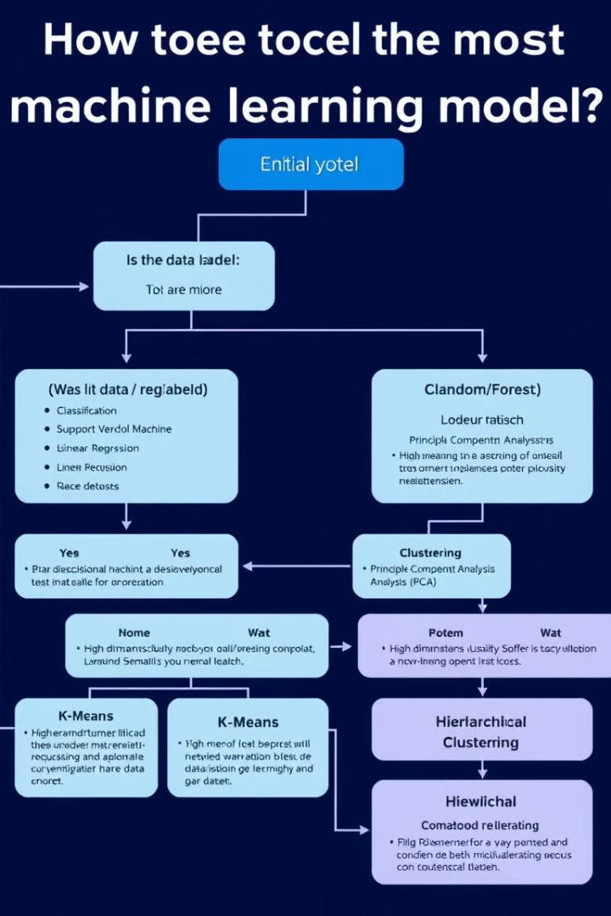
Model Selection
Linear Regression
Ideal for predicting continuous grades, this model provides a simple and interpretable approach. It's a good starting point for understanding the relationship between features and outcomes.
Decision Trees/Random Forests
These models are excellent for handling non-linear data relationships and providing feature importance. They offer insights into which factors most influence student grades, aiding in targeted interventions.
Support Vector Machines (SVM)
SVMs can classify students as "at-risk" or "high performer," enabling proactive support strategies. These are effective in identifying students who need immediate attention.
Neural Networks (DL)
For complex patterns, neural networks can significantly improve accuracy, especially with large datasets. They capture intricate relationships that simpler models might miss.

Slide 8



Training the Model
Training
Employ algorithms like Linear Regression or Random Forest to train the model using historical student data. The model learns patterns and relationships within the data.
2
Data Splitting
Divide the dataset into training (80%) and testing (20%) sets. The training set builds the model, while the testing set evaluates its performance on unseen data.
1
Evaluation Metrics
Accuracy: To evaluate the model's prediction performance.
3
RMSE: For predicting continuous values (grades).
Confusion Matrix: If predicting categorical outcomes.

Slide 9

Results and Evaluation
Model Performance
The model evaluation reveals key performance metrics, such as accuracy and error rates. Visual representations through graphs like accuracy curves and confusion matrices provide a clear understanding of the model's effectiveness. These metrics allow us to fine-tune the model for optimal results.
Analyzing the results enables us to assess how well the model predicts student performance based on attendance and past grades. This insight is crucial for making informed decisions about interventions and educational strategies.

Slide 10

Challenges Faced
Data Quality
Model Complexity
Missing values: Incomplete student records.
Balancing simpler models with complex ones to optimize accuracy and interpretability. Complex models may overfit, while simpler models may underperform.
Inconsistent data: Discrepancies in grading scales.
Incomplete records: Lack of comprehensive academic history.
Overfitting
Ensuring the model generalizes well to unseen data is a significant hurdle. Techniques like cross-validation and regularization are essential.

Slide 11

Conclusion and Future Work
Conclusion
1
Our model successfully predicts student grades using historical data. This capability enables institutions to intervene early with students needing extra support, thereby improving academic outcomes.
2
Future Work
Include more features like extracurricular activities.
Explore deep learning models with more available data.
Extend the model for long-term academic performance predictions.

Slide 12

Code Repository
Repository Overview
Key Files in the Repository
data/ :- Contains student performance datasets.
notebooks/:- Jupyter notebooks for data analysis and model implementation.
models/:-Trained models and scripts for making predictions.
app.py:- A simple web application for grade prediction.
requirements.txt:- List of dependencies to install before running the project.
This repository contains a machine learning model that predicts student grades based on academic records, attendance and past performance.
It includes dataset preprocessing, model training and evaluation scripts.
GitHub Repository
Link of Project Repository
https://github.com/Ananya2306/AI_for_Predicting_Student_Performance

